Slide 1
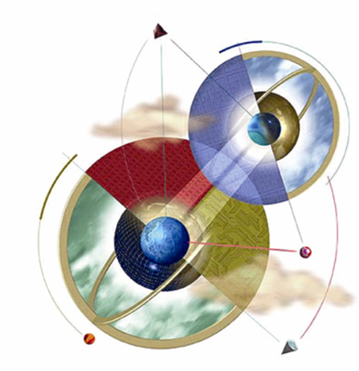
Expert System
Swarup Kr Ghosh
swarupg1@gmail.com

Slide 2
What is an expert system?
“An expert system is a computer system that emulates, or acts in all respects, with the decision-making capabilities of a human expert.”
Professor Edward Feigenbaum
Stanford University

Slide 3
Expert Systems
ES become successful after realization that “to make a program intelligent provide lots of high quality specific knowledge about some problem area.”
An expert system is a computer program that is designed to hold the accumulated knowledge of one or more domain experts.
Knowledge: which allows to make some decision.

Slide 4
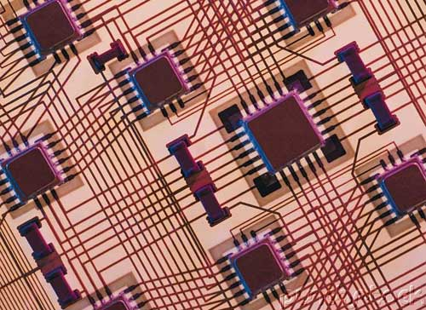

Applications of Expert Systems
MYCIN:
Medical system for diagnosing blood disorders. First used in 1979
DESIGN ADVISOR:
Gives advice to designers of processor chips

Slide 5

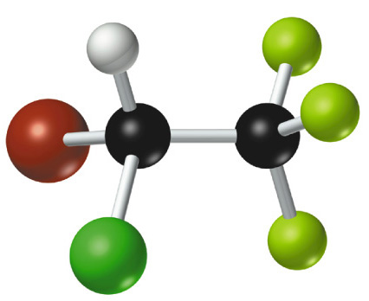
Applications of Expert Systems
DENDRAL: Used to identify the structure of chemical compounds. First used in 1965
LITHIAN: Gives advice to archaeologists examining stone tools

Slide 6
How human expert works?
Knowledge is a theoretical or practical understanding of a subject or a domain.
Domain expert: Anyone can be considered a domain expert if he or she has deep knowledge (of both facts and rules) and strong practical experience in a particular domain.
Most experts are capable of expressing their knowledge in the form of rules for problem solving.
IF the ‘traffic light’ is green
THEN the action is go
IF the ‘traffic light’ is red
THEN the action is stop

Slide 7
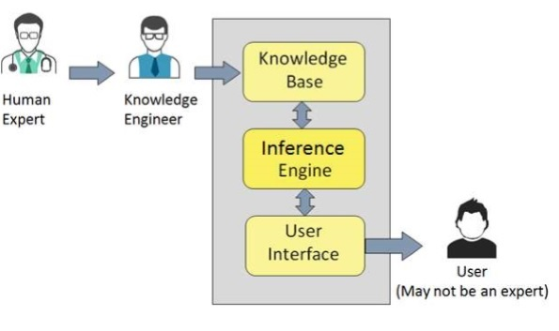
Component of ES
Facts
Rules
Interpreter
Scheduler

Slide 8
Components of an Expert System
The knowledge base is the collection of facts and rules which describe all the knowledge about the problem domain.
Facts: known information
Rules: use facts as basis of decision making
The inference engine is the part of the system that chooses which facts and rules to apply when trying to solve the user’s query.
Interpreter: what rules to apply
Scheduler: the order in which rules are to be applied
The user interface is the part of the system which takes in the user’s query in a readable form and passes it to the inference engine. It then displays the results to the user.
Remark: All expert system is knowledge base system but the converse is not true

Slide 9
Structure of Inference Engine
Nature of the problem domain
The way in which knowledge is represented or organize in ES.

Slide 10
KNOWLEDGE REPRESENTATION TECHNIQUES:
Rule based approach
Semantic nets
Frame based approach

Slide 11
Rules as a knowledge representation technique
The term rule in AI, which is the most commonly used type of knowledge representation, can be defined as an IF-THEN structure that relates given information or facts in the IF part to some action in the THEN part. A rule provides some description of how to solve a problem.
Rules are relatively easy to create and understand.
Any rule consists of two parts: the IF part, called the antecedent (premise or condition) and the THEN part called the consequent (conclusion or action).

Slide 12
IF <antecedent>
THEN <consequent>
A rule can have multiple antecedents joined by the keywords AND (conjunction), OR (disjunction) or
a combination of both.
IF <antecedent 1> IF <antecedent 1>
AND <antecedent 2> OR <antecedent 2>
. .
. .
. .
AND <antecedent n> OR <antecedent n>
THEN <consequent> THEN <consequent>

Slide 13
The antecedent of a rule incorporates two parts: an object (linguistic object) and its value. The object and its value are linked by an operator.
The operator identifies the object and assigns the value. Operators such as is, are, is not, are not are used to assign a symbolic value to a linguistic object.
Expert systems can also use mathematical operators to define an object as numerical and assign it to the numerical value.
IF ‘age of the customer’ < 18
AND ‘cash withdrawal’ > 1000
THEN ‘signature of the parent’ is required

Slide 14
Rules can represent relations, recommendations, directives, strategies and heuristics:
Relation
IF the ‘fuel tank’ is empty
THEN the car is dead
Recommendation
IF the season is autumn
AND the sky is cloudy
AND the forecast is drizzle
THEN the advice is ‘take an umbrella’
Directive
IF the car is dead
AND the ‘fuel tank’ is empty
THEN the action is ‘refuel the car’

Slide 15
Strategy
IF the car is dead
THEN the action is ‘check the fuel tank’;
step1 is complete
IF step1 is complete
AND the ‘fuel tank’ is full
THEN the action is ‘check the battery’;
step2 is complete
Heuristic
IF the spill is liquid
AND the ‘spill pH’ < 6
AND the ‘spill smell’ is vinegar
THEN the ‘spill material’ is ‘acetic acid’

Slide 16
The main players in the development team
There are five members of the expert system development team: the domain expert, the knowledge engineer, the programmer, the project manager and the end-user.
The success of their expert system entirely depends on how well the members work together.

Slide 17
The main players in the development team

Slide 18
Basic structure of a rule-based expert system

Slide 19
The knowledge base contains the domain knowledge useful for problem solving. In a rule-based expert system, the knowledge is represented as a set of rules. Each rule specifies a relation, recommendation, directive, strategy or heuristic and has the IF (condition) THEN (action) structure. When the condition part of a rule is satisfied, the rule is said to fire and the action part is executed.
The database includes a set of facts used to match against the IF (condition) parts of rules stored in the knowledge base.

Slide 20
The inference engine carries out the reasoning whereby the expert system reaches a solution.
The explanation facilities the user can ask the expert system how a particular conclusion is reached and why a specific fact is needed.
The user interface is the communication between a user seeking a solution to the problem and an expert system.

Slide 21
Complete structure of a rule-based expert system

Slide 22
Characteristics of an expert system
An expert system is built to perform at a human expert level in a narrow, specialised domain. Thus, the most important characteristic of an expert system is its high-quality performance. No matter how fast the system can solve a problem, the user will not be satisfied if the result is wrong.
On the other hand, the speed of reaching a solution is very important. Even the most accurate decision or diagnosis may not be useful if it is too late to apply, for instance, in an emergency, when a patient dies or a nuclear power plant explodes.

Slide 23
Expert systems apply heuristics to guide the reasoning and thus reduce the search area for a solution.
A unique feature of an expert system is its explanation capability. It enables the expert system to review its own reasoning and explain its decisions.
Expert systems employ symbolic reasoning when solving a problem. Symbols are used to represent different types of knowledge such as facts, concepts and rules.

Slide 24
Forward chaining and backward chaining
In a rule-based expert system, the domain knowledge is represented by a set of IF-THEN production rules and data is represented by a set of facts about the current situation. The inference engine compares each rule stored in the knowledge base with facts contained in the database. When the IF (condition) part of the rule matches a fact, the rule is fired and its THEN (action) part is executed.
The matching of the rule IF parts to the facts produces inference chains. The inference chain indicates how an expert system applies the rules to reach a conclusion.

Slide 25
Inference engine cycles via a match-fire procedure

Slide 26
An example of an inference chain

Slide 27
Forward chaining
Forward chaining is the data-driven reasoning. The reasoning starts from the known data and proceeds forward with that data. Each time only the topmost rule is executed. When fired, the rule adds a new fact in the database. Any rule can be executed only once. The match-fire cycle stops when no further rules can be fired.

Slide 28
Forward chaining

Slide 29
Forward chaining is a technique for gathering information and then inferring from it whatever can be inferred.
However, in forward chaining, many rules may be executed that have nothing to do with the established goal.
Therefore, if our goal is to infer only one particular fact, the forward chaining inference technique would not be efficient.

Slide 30
Backward chaining
Backward chaining is the goal-driven reasoning. In backward chaining, an expert system has the goal (a hypothetical solution) and the inference engine attempts to find the evidence to prove it. First, the knowledge base is searched to find rules that might have the desired solution. Such rules must have the goal in their THEN (action) parts. If such a rule is found and its IF (condition) part matches data in the database, then the rule is fired and the goal is proved. However, this is rarely the case.

Slide 31
Backward chaining
Thus the inference engine puts aside the rule it is working with (the rule is said to stack) and sets up a new goal, a subgoal, to prove the IF part of this rule. Then the knowledge base is searched again for rules that can prove the subgoal. The inference engine repeats the process of stacking the rules until no rules are found in the knowledge base to prove the current subgoal.

Slide 32
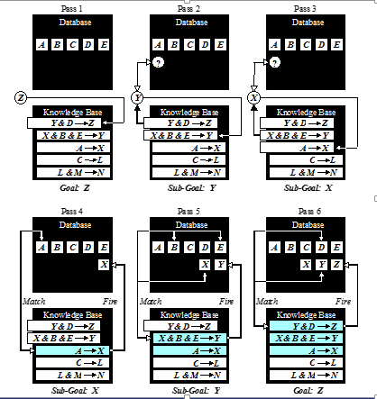
Backward chaining

Slide 33
How do we choose between forward and backward chaining?
If an expert first needs to gather some information and then tries to infer from it whatever can be inferred, choose the forward chaining inference engine. e.g. DENDRAL
However, if your expert begins with a hypothetical solution and then attempts to find facts to prove it, choose the backward chaining inference engine. e.g. MYCIN (diagnosis)

Slide 34
Conflict resolution
Earlier we considered two simple rules for crossing a road. Let us now add third rule:
Rule 1:
IF the ‘traffic light’ is green
THEN the action is go
Rule 2:
IF the ‘traffic light’ is red
THEN the action is stop
Rule 3:
IF the ‘traffic light’ is red
THEN the action is go

Slide 35
We have two rules, Rule 2 and Rule 3, with the same IF part. Thus both of them can be set to fire when the condition part is satisfied. These rules represent a conflict set. The inference engine must determine which rule to fire from such a set. A method for choosing a rule to fire when more than one rule can be fired in a given cycle is called conflict resolution.
In forward chaining, BOTH rules would be fired. Rule 2 is fired first as the topmost one, and as a result, its THEN part is executed and linguistic object action obtains value stop. However, Rule 3 is also fired because the condition part of this rule matches the fact ‘traffic light’ is red, which is still in the database. As a consequence, object action takes new value go.

Slide 36
Methods used for conflict resolution
Fire the rule with the highest priority. In simple applications, the priority can be established by placing the rules in an appropriate order in the knowledge base. Usually this strategy works well for expert systems with around 100 rules.
Fire the most specific rule. This method is also known as the longest matching strategy. It is based on the assumption that a specific rule processes more information than a general one.

Slide 37
Fire the rule that uses the data most recently entered in the database. This method relies on time tags attached to each fact in the database. In the conflict set, the expert system first fires the rule whose antecedent uses the data most recently added to the database.

Slide 38
Metaknowledge
Metaknowledge can be simply defined as knowledge about knowledge. Metaknowledge is knowledge about the use and control of domain knowledge in an expert system.
In rule-based expert systems, metaknowledge is represented by metarules. A metarule determines a strategy for the use of task-specific rules in the expert system.

Slide 39
Metarules
Metarule 1:
Rules supplied by experts have higher priorities than rules supplied by novices.
Metarule 2:
Rules governing the rescue of human lives have higher priorities than rules concerned with clearing overloads on power system equipment.

Slide 40
Advantages of Expert Systems
Increased availability
Reduced cost
Reduced danger
Performance
Multiple expertise
Increased reliability
Explanation
Fast response
Steady, unemotional, and complete responses at all times
Intelligent tutor
Intelligent database

Slide 41
Human Expert vs Artificial Expert
Human Expert
Artificial Expert
Perishable
Difficult to transfer
Difficult to document
Unpredictable
Expensive
Creative
Adaptive
Scenery experience
Broad focus
Common sense knowledge
Permanent
Easy to transfer
Easy to document
Consistent
Affordable
Uninspired
Need to be told
Symbolic input
Narrow focus
Technical knowledge

Slide 42

Why use Expert Systems?
Experts are not always available. An expert system can be used anywhere, any time.
Human experts are not 100% reliable or consistent
Experts may not be good at explaining decisions
Cost effective

Slide 43
Problems with Expert Systems
Limited domain
Systems are not always up to date, and don’t learn
No “common sense”
Experts needed to setup and maintain system

Slide 44
Can expert systems make mistakes?
Even a brilliant expert is only a human and thus can make mistakes. This suggests that an expert system built to perform at a human expert level also should be allowed to make mistakes. But we still trust experts, even we recognise that their judgements are sometimes wrong. Likewise, at least in most cases, we can rely on solutions provided by expert systems, but mistakes are possible and we should be aware of this.

Slide 45
Expert Systems on the Web
http://www.aiinc.ca/demos/whale.html
http://www.vanguardsw.com/ decisionscript/examples.htm
http://www.exsys.com/demomain.html
http://www.expertise2go.com/webesie/car
http://www.expertise2go.com/webesie/wine

Slide 46
THANK YOU

